Slide 1
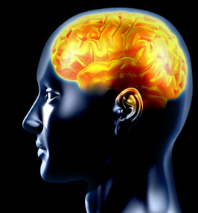
Schizophrenia and Dissociative Identity Disorder

Slide 2
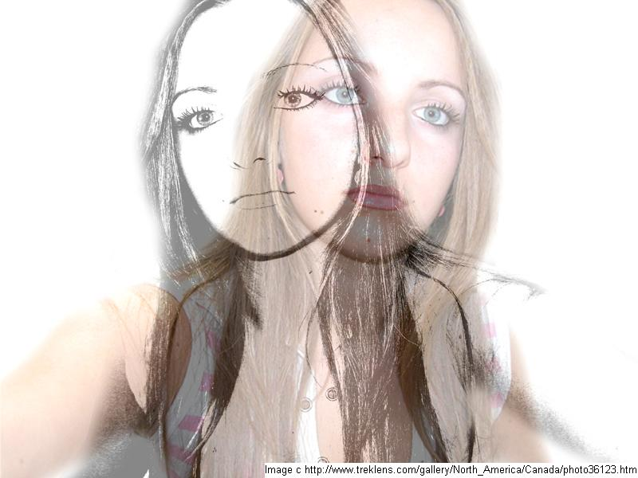
Schizophrenia: Cardinal Features
Delusions
Hallucinations
Disorganized speech (e.g., frequent derailment or incoherence)
Grossly disorganized or catatonic behavior
Negative symptoms, i.e.,
affective flattening, alogia,
or avolition

Slide 3
Schizophrenia: Cardinal Features
Characteristic Symptoms (Previous Slide)
Social / Occupational Dysfunction
Duration
Schizoaffective & Mood Disorder exclusion
Substance / General Medical Condition exclusion
Relationship to a PDD

Slide 4
Schizophrenia: Cardinal Features DSM-V Proposed Revisions
Delusions
Hallucinations
Disorganized speech (e.g., frequent derailment or incoherence)
Grossly disorganized or catatonic behavior catatonia
Negative symptoms, i.e., affective flattening, restrictive affect, alogia, or avolition/asociality

Slide 5
Schizophrenia: Differential Diagnosis Related Psychotic Disorders
Schizophreniform
Delusional Disorder
Brief Psychotic Disorder
Shared Psychotic Disorder*
Psychotic Disorder Due to a General Medical Condition
Substance-Induced Psychotic Disorder
* Eliminated in Currently Proposed DSM-V

Slide 6
Schizophrenia: Differential Diagnosis Relationship to Mood Disorders
Schizoaffective Disorder
Major Depressive Episode/Manic Episode/Mixed Episode CONCURRENT with Criterion A of Schizophrenia
At least 2 weeks of delusions or hallucinations without mood symptoms
Mood disturbance is present during a significant portion of illness
Not due to general medical condition or substance
Mood Disorder, Severe with Psychotic Features

Slide 7
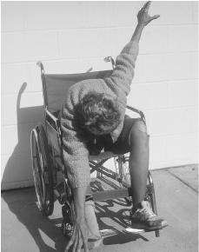
Schizophrenia: Differential Diagnosis Subtypes of Schizophrenia
Catatonic Type
Disorganized Type
Paranoid Type
Undifferentiated Type
Residual Type

Slide 8
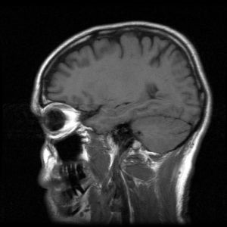
Schizophrenia: Etiology
Genetic
Neurotransmitters
Brain Structure & Function
Psychological Stress

Slide 9
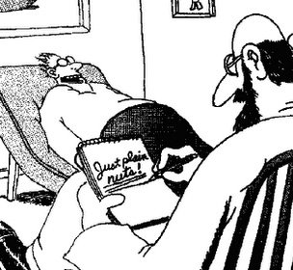
Schizophrenia: Treatment
Medication
Psychotherapy
Supportive Services
Residential Treatment

Slide 10
Dissociative Identity Disorder: 300.14 DSM-IV-TR- Diagnostic Criteria
A. Two or more distinct identities or personality states…
B. At least two of which recurrently take control of the person’s behavior.
C. Inability to recall important personal info. Which cannot be explained by ordinary forgetfulness.
D. Not due to the direct physiological effects of a substance or a general medical condition. Note: In children, the symptoms are not attributable to imaginary playmates or other fantasy play.

Slide 11
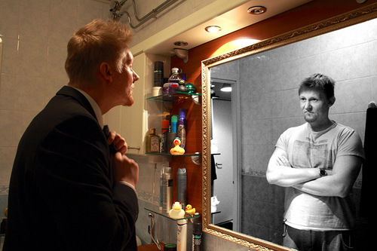
DID: Cardinal Features
Failure to integrate different
parts of identity, memory, and consciousness.
Distinct personal history, self-image, and identity, including separate name for each identity- usually opposite of primary identity.
Specific settings/circumstances may trigger emergence of certain identities.
Role of primary identity.
http://www.youtube.com/watch?v=MUDbB5zB9xY
Notes:
*DID is understood to be as a result of a person’s failure to integrate various aspects of identity, memory, and consciousness.
*Each of a DID person’s identities may be experienced as if they have their own separate personal history, self-image, age, gender, name, vocabulary, general knowledge, predominant affect and identity.
* In some cases specific identities come out in specific circumstances, in other cases the identities appear in a particular sequence. The identities may appear to jokey for control of each other, be in conflict with each other, or deny the existence of each other. It is also possible for a lead identity to take charge of when each of the identities can appear. “Aggressive or hostile identities may at times interrupt activities or place the others in uncomfortable situations” (DSM p. 526)

Slide 12
Dissociative Identity Disorder: Proposed Revisions for DSM-V
A. Disruption of identity characterized by two or more distinct personality states or an experience of possession, as evidenced by discontinuities in sense of self, cognition, behavior, affect, perceptions, and/or memories. This disruption may be observed by others or reported by the patient.
B. Inability to recall important personal information, for everyday events or traumatic events, that is inconsistent with ordinary forgetfulness.
C. Causes clinically significant distress or impairment in social, occupational, or other important areas of functioning. *
D. The disturbance is not a normal part of a broadly accepted cultural or religious practice and is not due to the direct physiological effects of a substance (e.g., blackouts or chaotic behavior during Alcohol intoxication) or a general medical condition (e.g., complex partial seizures). NOTE: In children, the symptoms are not attributable to imaginary playmates or other fantasy play.
Specify if:**
a) With non-epileptic seizures or other conversion symptoms
b) With somatic symptoms that vary across identities (excluding those in specifier a)
* The workgroup will further consider whether Criterion C is necessary
** These specifiers are under consideration.
Notes:
The following are the proposed changes to the diagnostic criteria for Dissociative Identity Disorder in the upcoming DSM-V.
They include a change in language and wording in criteria A so that it will include both reported and observed identities in order to help reduce the use of Dissociative Disorder Not Otherwise Specified. The inclusion of Trance and Possession Disorder in this criteria was also added to address multiculturalism and increase global functioning.
In criteria B the wording was changed to emphasize that amnesia for everyday events is a common feature of this dissorder.
Criteria C, which is also in the DSM-IV Dissociative Trance Disorder criterion, was added to help differentiate normative cultural experiences from psychopathology. The workgroup is still trying to determine if the addition of this criterion is necessary.
Part of Criteria D was added from the DSM-IV criteria for Dissociative Trance Disorder to increase cross-cultural applicability.
Two specifiers were also added to the diagnotist criteria. Specifier A was added because “A substantial proportion of patients with Dissociative Identity Disorder have conversion symptoms, which are related to their dissociative disorder and require special clinical attention and treatment”. Specifier B was added because some Dissociative Identity Disorder patients have dissociative variations in somatic symptoms that require clarification for differential medical diagnosis and treatment.
Reference: Spiegel D et al. (Depression & Anxiety; in preparation)

Slide 13
Dissociative Identity Disorder: Differential Diagnosis
Distinguish from:
Symptoms caused by the direct physiological effects of a general medical condition (e.g. seizure disorder).
Symptoms caused by the direct physiological effects of a substance
Diagnosis of DID trumps: Dissociative Amnesia, Dissociative Fugue and Depersonalization Disorder.

Slide 14
DID: Differential Diagnosis, Continued
Differentiate from: Schizophrenia and other Psychotic Disorders, Bipolar Disorder, With Rapid Cycling, Anxiety Disorders, Somatization Disorders and Personality Disorders as well as Malingering and Factitious Disorder.
Notes:
DID can be distinguished by “the presence of a clear-cut dissociative symptomology with sudden shifts in identity states, the persistence and consistency of identity-specific demeanors and behaviors over time, reversible amnesia, evidence of dissociative behavior that predates the clinical or forensic presentation and high scores on measures of dissociation and hypnotizability in individuals who do not have the characteristics of another mental disorder.
DID is often misdiagnosed as a psychotic disorder because of the presence of auditory hallucinations. In DID the voices will present as coming from inside the patients head, not outside their head which is the case in psychotic disorders. Also differentiating the auditory hallucinations in DID from psychotic disorders is that patients with DID are often aware that the voices they are hearing are hallucinations.

Slide 15
Dissociative Identity Disorder: Etiology
Those diagnosed with DID are also often victims of severe physical pain and sexual abuse during childhood.
The “developmental window” and imaginary playmates
DID as related to PTSD
Biological factors
Notes:
In one study, Putnam (as cited in Durrand & Barlow, 2010, p. 192) 97% of the patients out of 100 cases of patients with DID reported having experienced “significant trauma, usually sexual or physical abuse”. Examples of some of the abuses suffered by DID patients as children include: being buried alive, being tortured with matches, steam irons, razor blades or glass.
Based on the evidence provided by studies such as these there is significant agreement that DID is the result of the patient trying to escape of “dissociate” from the trauma of severe abuse (Durrand & Barlow, 2010, p. 192). The difficulty with this hypothesis is that not all people who suffer extreme trauma/abuse develop DID.
Additionally there is a concept, referred to as the “developmental window” which indicates that there is a time period that closes around age 9 wherein children who suffer abuse are vulnerable to developing DID.
Some professionals believe that DID may be “an extreme subtype of PTSD” wherein the symptom of dissociation is much more pronounced than the symptoms of anxiety.
Another similarity between PTSD and DID is the biological tendency for those with these disorders to have smaller than normal volume of hippocampus and amygdala. It is posited that there are other biological vulnerabilities that lead to the development of DID but there is currently not enough research to support specific leads.

Slide 16
Dissociative Identity Disorder: Treatment ☺
Long-term psychotherapy
Reintegration of identities
Coons (1986) study 5 out of 20 patients (25%) achieved full integration of identities
Ellason & Ross (1997) 12 out of 54 patients (22.2%) achieved integration after 2years of treatment
Identify and neutralize triggers
Medication
Notes:
In the absence of controlled research, success has been reported with the use of long-term psychotherapy and identity reintegration.
Some pages out of the book of PTSD treatment strategies have also been successfully applied to DID which include identifying cues or triggers of traumatic memories, and/or dissociation and then work to neutralize them. In this process the patient has to “confront, relive and gain control over the traumatic past events” (Durrand & Barlow, 2010, p. 195). Hypnosis can be utilized in this process to help the patient access unconscious memories and bring alter identities into awareness.
DID is understood to be a chronic disorder which means that it is highly unlikely to improve without intensive and target treatment. It is important for clinicians to remain aware of the possibility that reemerging memories of trauma may trigger further dissociation.
The use of medication in the treatment of DID is still being explored, however currently there is not a lot of evidence to support its effectiveness. What little support there is for the use of medication is limited to the use of antidepressants, which would only be appropriate to consider in some cases (Durrand & Barlow, 2010, p. 195).

Slide 17
DID & Demon Possession
Demon possession or commanding auditory hallucinations?
1484- the Malleus Maleficarum
Demon possession and the Bible
Luke 8:2 – Seven demons cast out of Mary Magdalene
Mark 5 – “’Legion’ For we be many,” Jesus cast demons into herd of pigs
Acts 16:16-18 – Slave girl healed by Paul
Notes:
The voices that DID patients hear as their auditory hallucinations can direct them to do things that that patient does not want to do. This occurrence can, particularly in other cultures, result in the appearance of the patient being possessed by demons. (Durand and Barlow, 2010, p. 191). Yarhouse, Butman and McRay (2005) posit that the “bizarre behavior associated with schizophrenia and related disorders led many to diagnose sufferers as suffering from demonic influence” this has particularly been the case in faith-based communities (p. 251).
In 1484 the Malleus Maleficarum, a medieval witch-hunting manual, was released and gave guidelines for how to decipher who was “demon possessed”. This book was directly associated with the death of tens of thousands of persons, the majority of which were women.
-----
Demon possession is found in multiple passages in the Bible. Some of the most famous include those on the slide. In Luke 8:2, Mary Magdalene is mentioned as having 7 demons cast out of her. In Mark 5 Jesus cast the demons out of the individual whose demons stated they were called “Legion, for we be many.” When the demons were cast out the man went from being naked and uncontrollable to clothed, and “in his right mind.” It was on this occasion that Jesus cast the demons into a herd of pigs, which subsequently ran off a cliff, into the sea, and drowned. In Acts 16, Paul, Luke, and others were followed for many days by a slave girl with a “spirit of divination.” After getting tired of her following them and announcing who they were, Paul cast the spirit out of her, at which point the men realized they couldn’t use her to make money anymore.
Today, different religious beliefs contain different ideas about demon possession.
Hatian voodoo esteem certain forms of spiritual possession in trances (Johnson & Friedman, 2008)
The Catholic Church recognizes demon possession today in rare cases and performs exorcisms, but is careful to distinguish between demon possession and mental illness – recognizing a difference between the two.
Some believe that demon possession was Schizophrenia or DID, and that they didn’t know how to recognize it
Others believe that demon possession was instead limited to Biblical times and no longer occurs

Slide 18
References
American Psychiatric Association. (2000). Diagnostic and statistical manual of mental disorders (Revised 4th ed.). Washington, DC: Author.
American Psychiatric Association. (2010). Proposed draft revisions to DSM disorders and criteria, DSM-5. Retrieved from: http://www.dsm5.org
Durand, V. M., & Barlow, D. H. (2010). Essentials of abnormal psychology (5th ed.). Belmont, CA: Wadsworth.
Johnson, C. V., & Friedman, H. L. (2008). Enlightened or delusional? Differentiating religious, spiritual, and transpersonal experiences from psychopathology. Journal of Humanistic Psychology, 48, 505-527. doi: 10.1177/0022167808314174
Kring, A. M., Davison, G. C., Neale, J. M., & Johnson, S. L. (2007). Abnormal psychology (10th ed.). Hoboken, NJ: John Wiley & Sons, Inc.
Maxmen, J. S., & Ward, N. G. (1995). Essential psychopathology and its treatment (2nd ed., Revised). New York, NY: W. W. Norton & Company, Inc.
Sadock, B. J., & Sadock, V. A. (2008). Kaplan & Sadock’s concise textbook of clinical psychiatry (3rd ed.). Philadelphia, PA: Lippincott Williams & Wilkins.
Tai, S., & Turkington, D. (2009). The evolution of cognitive behavior therapy for schizophrenia: Current practice and recent developments. Schizophrenia Bulletin, 35, 865-873. doi: 10.1093/schbul/sbp080
Yarhouse, M., Butman, R., & McRay, B. (2005). Modern psychopathologies: A comprehensive Christian appraisal. Downer’s Grove: Intervarsity Press.
Notes:
The voices that DID patients hear as their auditory hallucinations can direct them to do things that that patient does not want to do. This occurrence can, particularly in other cultures, result in the appearance of the patient being possessed by demons. (Durand and Barlow, 2010, p. 191). Yarhouse, Butman and McRay (2005) posit that the “bizarre behavior associated with schizophrenia and related disorders led many to diagnose sufferers as suffering from demonic influence” this has particularly been the case in faith-based communities (p. 251).
In 1484 the Malleus Maleficarum, a medieval witch-hunting manual, was released and gave guidelines for how to decipher who was “demon possessed”. This book was directly associated with the death of tens of thousands of persons, the majority of which were women.

